Slide 1

Poster presentation
1200mm
Free format for the poster.
Size should be no larger than the poster board (show right figure).
Please print your poster by yourself and bring it with you on the day.
Pins for posting will be provided by the Secretariat.
Poster
area
1800mm
Poster board
Floor
Use this if you want to include the ISPF logo.

Slide 2
Oral presentation
Free format for the slide.
Presentation time is 10 minutes and 5 minutes for discussion, for a total of 15 minutes.
Use this if you want to include the ISPF logo.

Slide 3
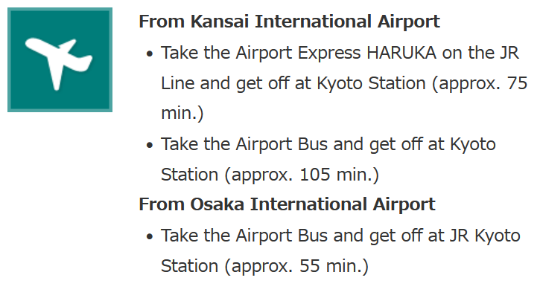
Accommodation
The accommodation is "Kyoto Dai-ichi Hotel“ for young researchers.
https://www.kyoto-1-hotel.jp/english/
Please make your own arrangements about transportation from KIX.
The hotel has been reserved by ISPF for non-smoking single rooms with breakfast for the period 10-15 March, 2024 (5 nights) .
The accommodation fee will be paid by the ISPF Committee.

Slide 4
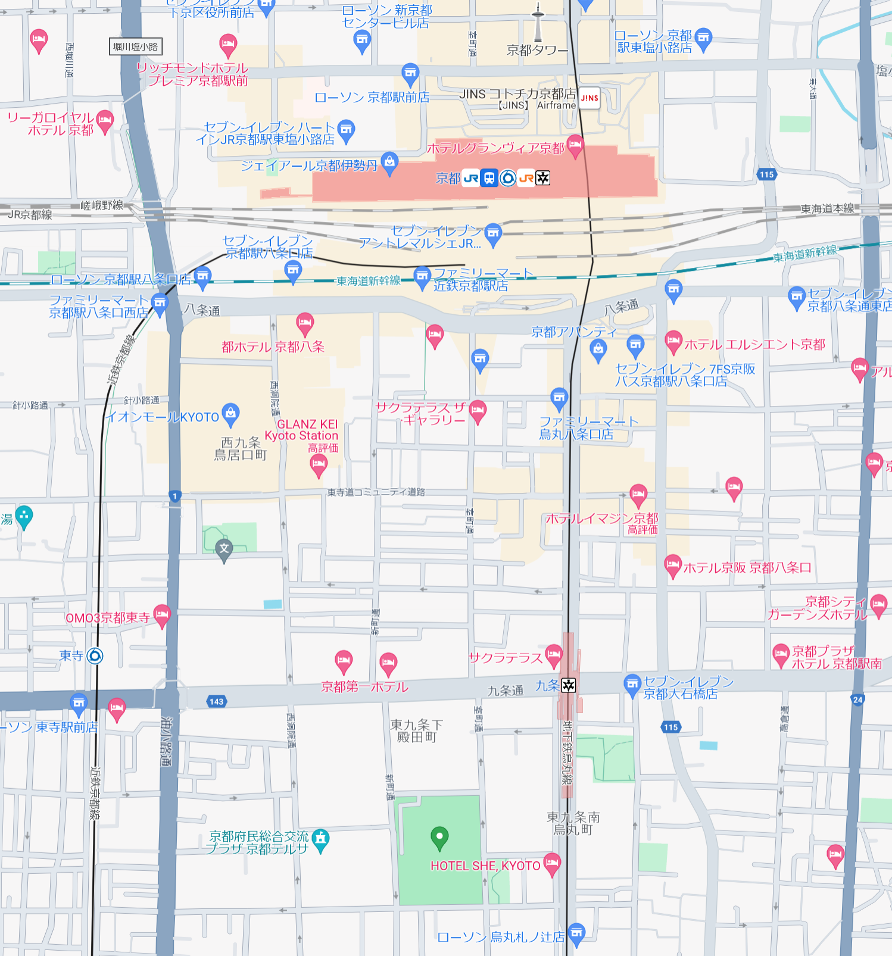
Venue of the seminar
KYOTO TERRSA
https://www.kyoto-terrsa.or.jp/
About 300m from Kyoto Dai-ichi Hotel. (5min by walk)
Kyoto station
Subway
Karasuma line
“Kujo station”
Kintetsu
Kyoto line
“Toji station”
Accommodation
Kyoto Dai-ichi Hotel
Seminar(11th 12th March), Welcome party(11th March)
Kyoto Terrsa

